Slide 1

Taste of Manchester
Vicky Shao
05/08/2020

Slide 2
Business Problem
Target Audience:
People who wants or plans to run a catering business in Manchester.
Key Factors
1. Where is the best location?
2. What kind of restaurant?

Slide 3
Data Resource
The coverage of the postcode districts of Manchester from Wikipedia. https://en.wikipedia.org/wiki/M_postcode_area
The geospatial data of each area in Manchester according to the postcode. https://www.doogal.co.uk/UKPostcodes.php
Data from Foursquare will be used to provide information about which types of venues and restaurants are popular in each area of Manchester.

Slide 4
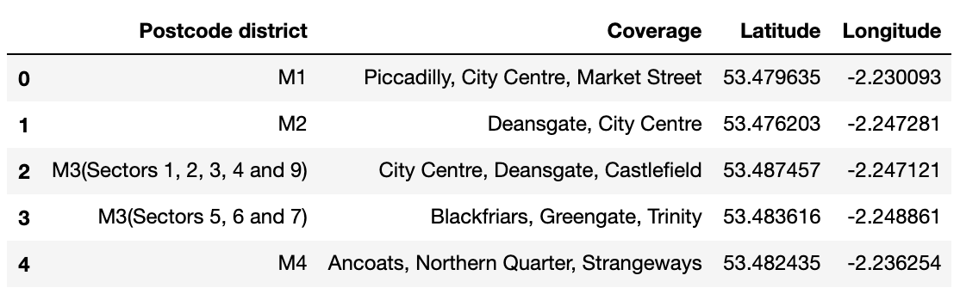
Geospatial information of different coverages in Manchester

Slide 5
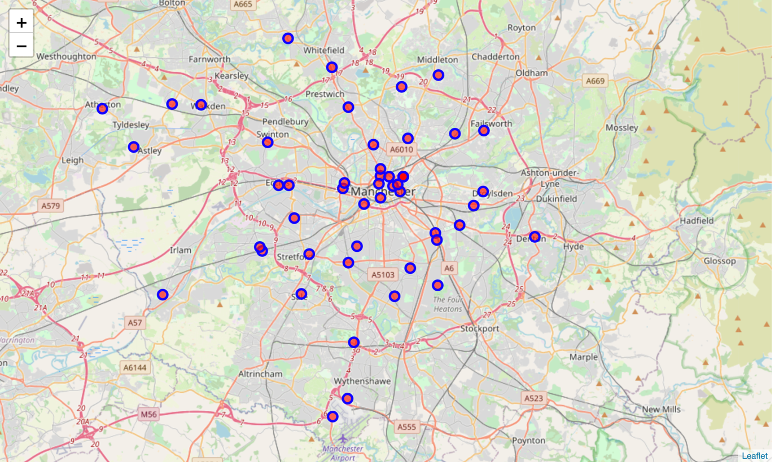
The map of Manchester and its 52 postcode districts

Slide 6
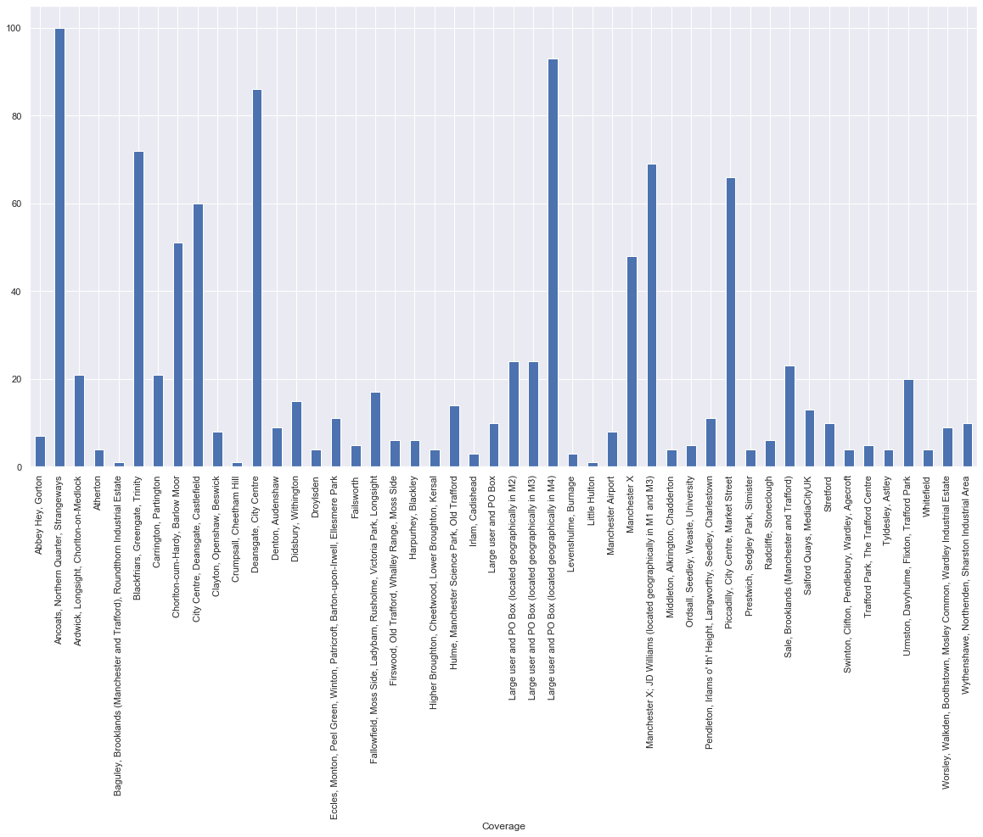
Number of venues in different coverages in Manchester

Slide 7
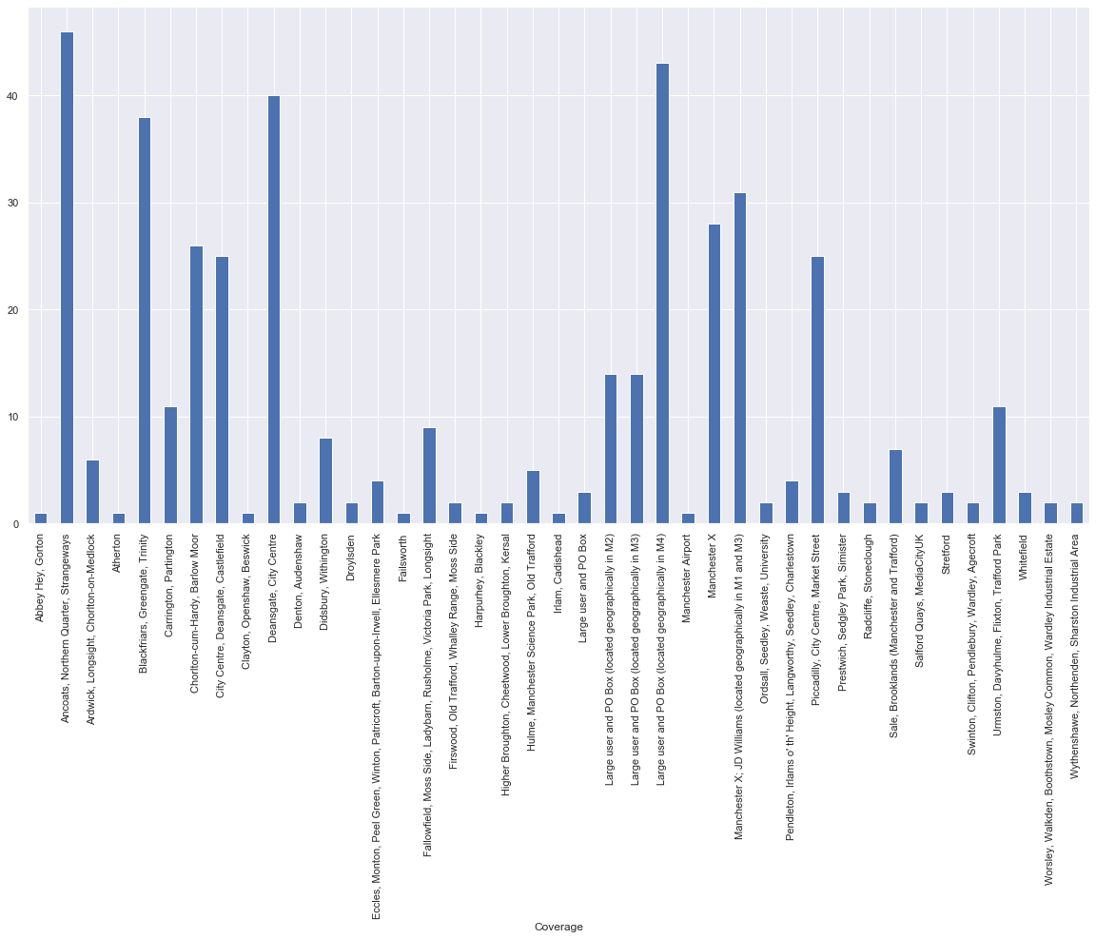
Number of restaurants in different coverages in Manchester

Slide 8
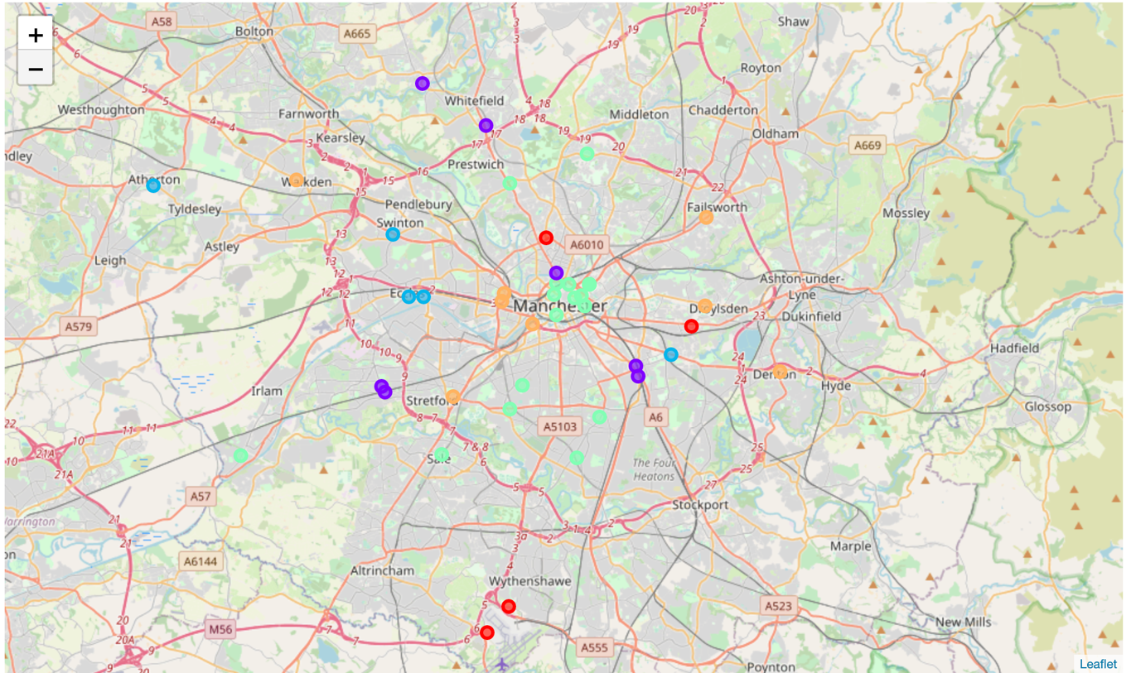
Cluster the coverages

Slide 9
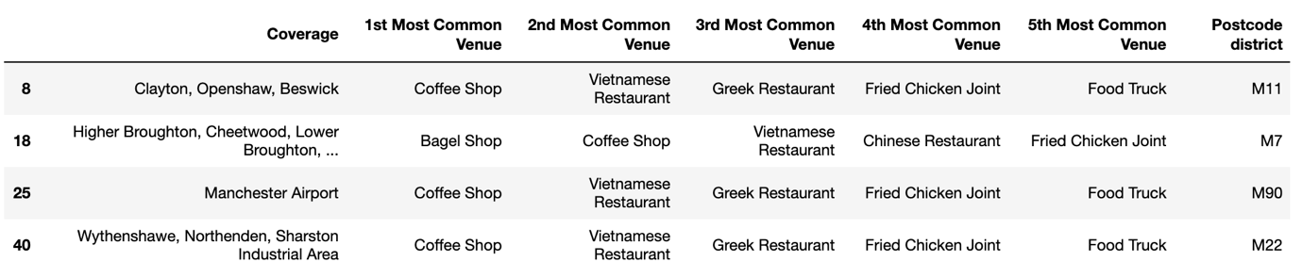
Coverages and their five common restaurants in cluster 0

Slide 10
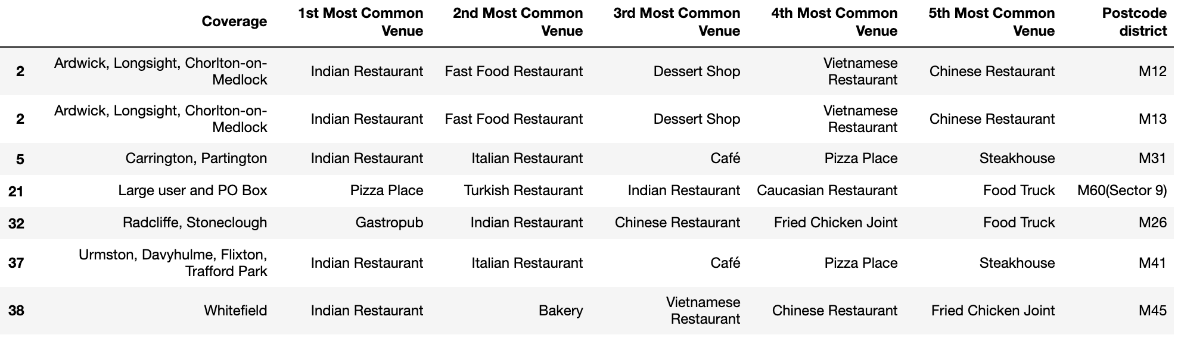
Coverages and their five common restaurants in cluster 1

Slide 11
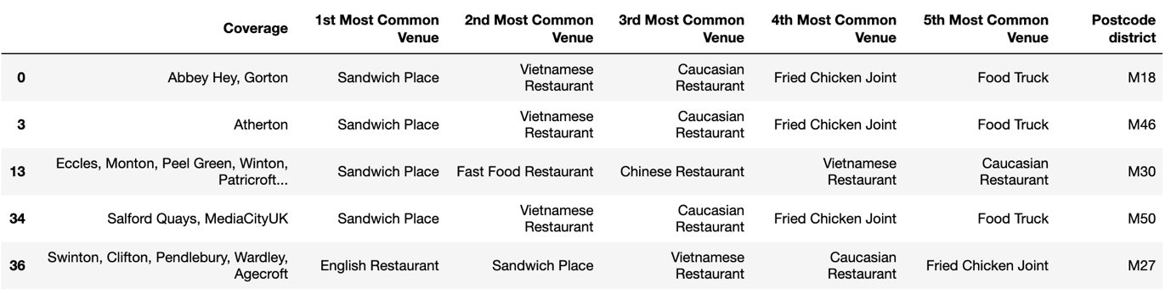
Coverages and their five common restaurants in cluster 2

Slide 12
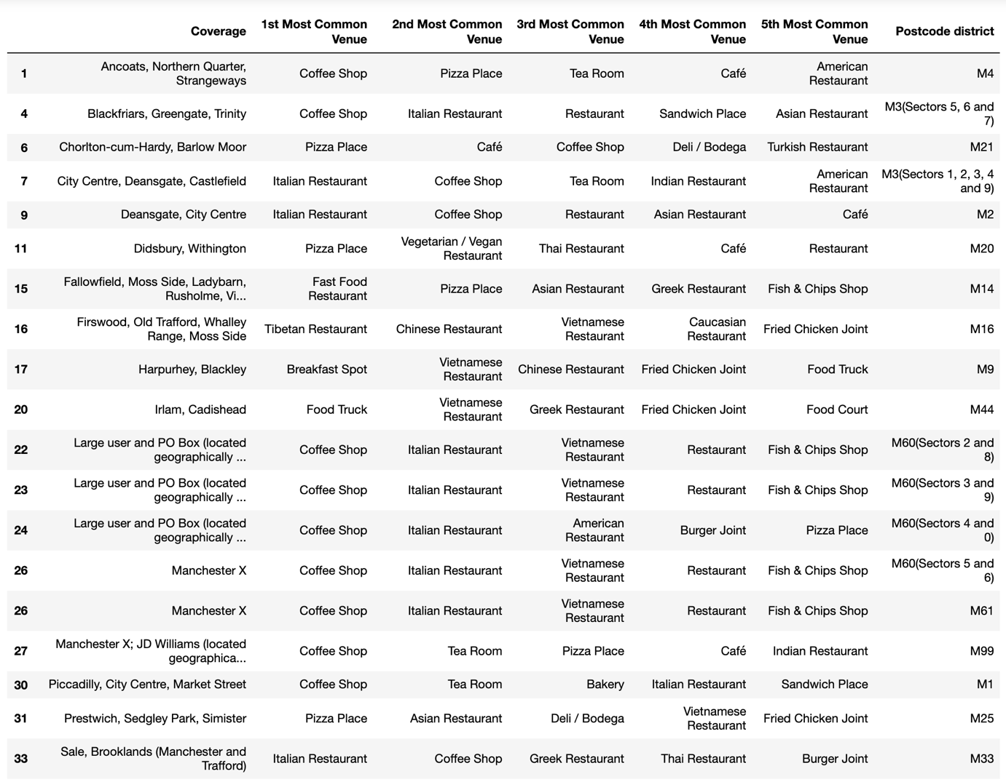
Coverages and their five common restaurants in cluster 3

Slide 13
Coverages and their five common restaurants in cluster 4

Slide 14
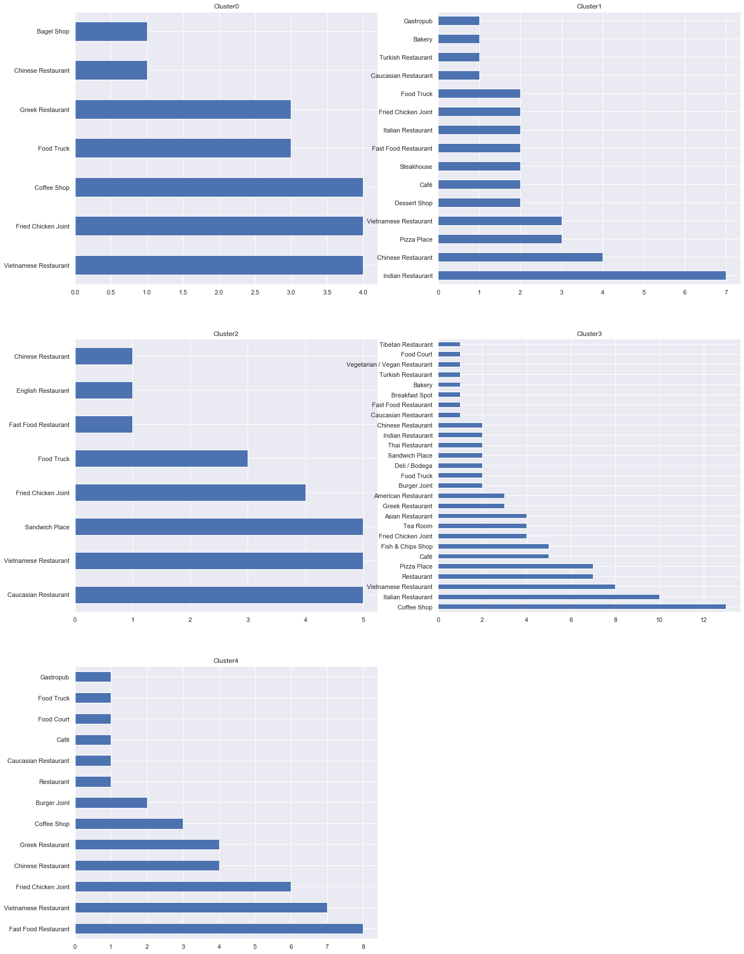
Distribution of the favourite restaurants – cluster 0 & cluster 1

Slide 15
Distribution of the favourite restaurants – cluster 2 & cluster 3 & cluster 4

Slide 16
Conclusion
For almost all the coverages, the number of restaurants is about 50% of the number of all kinds of venues.
Areas such as Piccadilly, City Centre, Market Street, Deansgate, Blackfriars, Greengate, Trinity, Manchester X, JD Williams have distinctly higher numbers of restaurants than other areas.
Each cluster of coverages has significant difference in the preference of the food type.
Recommendation: opening a coffee shop or Italian restaurant in the following places, Piccadilly, Market Street, Deansgate, Blackfriars, Greengate, Trinity or Manchester X.

Slide 17
Thank you very much.

